Slide 1
Name : Piterson Jean Charles(尚德勝)
ID: B97901192

Slide 2
Software Testing
Software testing is the process of evaluation a software item to detect differences between given input and expected output. Also to assess the feature of A software item. Testing assesses the quality of the product. In other words software testing is a verification and validation process.
Verification
Verification is the process to make sure the product satisfies the conditions imposed at the start of the development phase. In other words, to make sure the product behaves the way we want it to.
Validation
Validation is the process to make sure the product satisfies the specified requirements at the end of the development phase. In other words, to make sure the product is built as per customer requirements.
Basics of software testing
There are two basics of software testing: blackbox testing and whitebox testing.
Blackbox Testing ignores the internal mechanism of the system and focuses on the output generated against any input and execution of the system. It is also called functional testing.
Whitebox Testing takes into account the internal mechanism of a system. It is also called structural testing and glass box testing.
Black box testing is often used for validation and white box testing is often used for verification.

Slide 3
The Testing Spectrum testing done at each level of software development is different in nature and has different objectives.
-Unit Testing :is done at the lowest level. It tests the basic unit of software
-Integration Testing is performed when two or more tested units are combined into a larger structure.
-System Testing tends to affirm the end-to-end quality of the entire system, often based on the functional/requirement specification of the system
-Acceptance Testing: give confidence that the system is working than to find errors.
Static Analysis and Dynamic Analysis
Based on whether the actual execution of software under evaluation is needed or not
-Static Analysis: focuses on the range of methods that are used to determine or estimate software quality without reference to actual executions. code inspection, program analysis, symbolic analysis, and model checking.
-Dynamic Analysis: deals with specific methods for ascertaining and/or approximating software quality through actual executions, i.e., with real data and under real (or simulated) circumstances. synthesis of inputs, the use of structurally dictated testing procedures, and the automation of testing environment generation.
Notes:
http://www.cs.cmu.edu/~luluo/Courses/17939Report.pdf

Slide 4
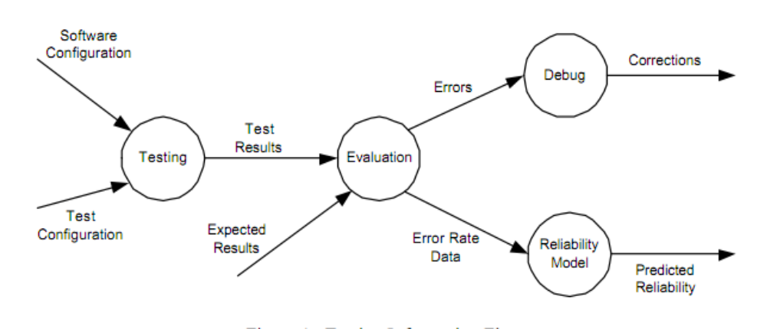
information flow of testing
Software Configuration: requirements specification, design specification, source code, and so on
Test Configuration: test cases, test plan and procedures, and testing tools.
testing technique specifies the strategy used in testing to select input test cases(set of conditions or variables) and analyze test results

Slide 5
Test Oracles

Slide 6
Introduction
Oracle : mechanism used by software testers and software engineers for determining whether a test has passed or failed
How ? By comparing the output(s) of the system under test ,for a given test case input ,to the outputs that the oracle determines that product should have

Slide 7
three capabilities
A generator: to provide predicted or expected results for each test.
A comparator: to compare predicted and obtained results.
An evaluator: to determine whether the comparison results are sufficiently close to be a pass.

Slide 8
Common oracles include:
specifications and documentation
other products (for instance, an oracle for a software program might be a second program that uses a different algorithm to evaluate the same mathematical expression as the product under test)
an heuristic oracle that provides approximate results or exact results for a set of a few test inputs.
a statistical oracle that uses statistical characteristics,
a consistency oracle that compares the results of one test execution to another for similarity
a model-based oracle that uses the same model to generate and verify system behavior,
or a human being's judgment (i.e. does the program "seem" to the user to do the correct thing?)

Slide 9
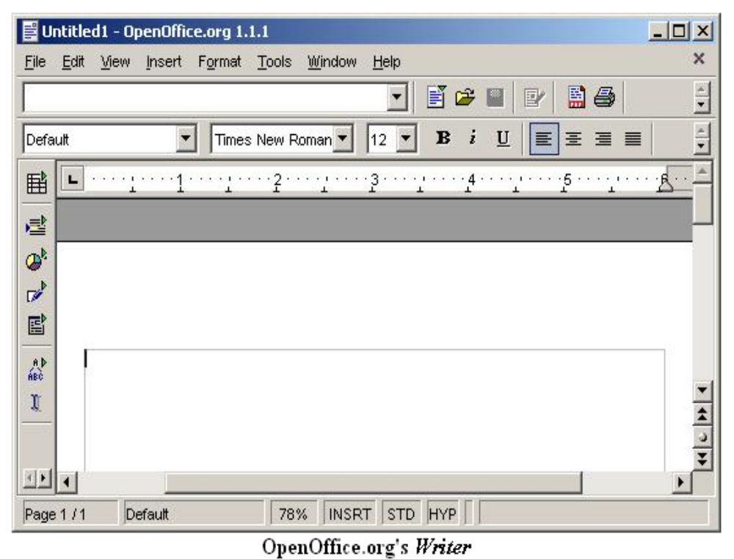

Slide 10
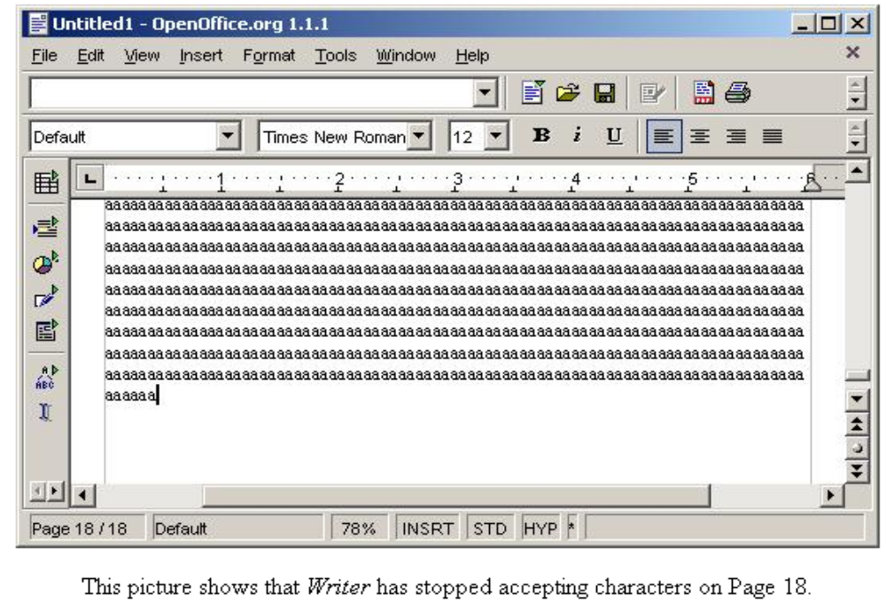

Slide 11
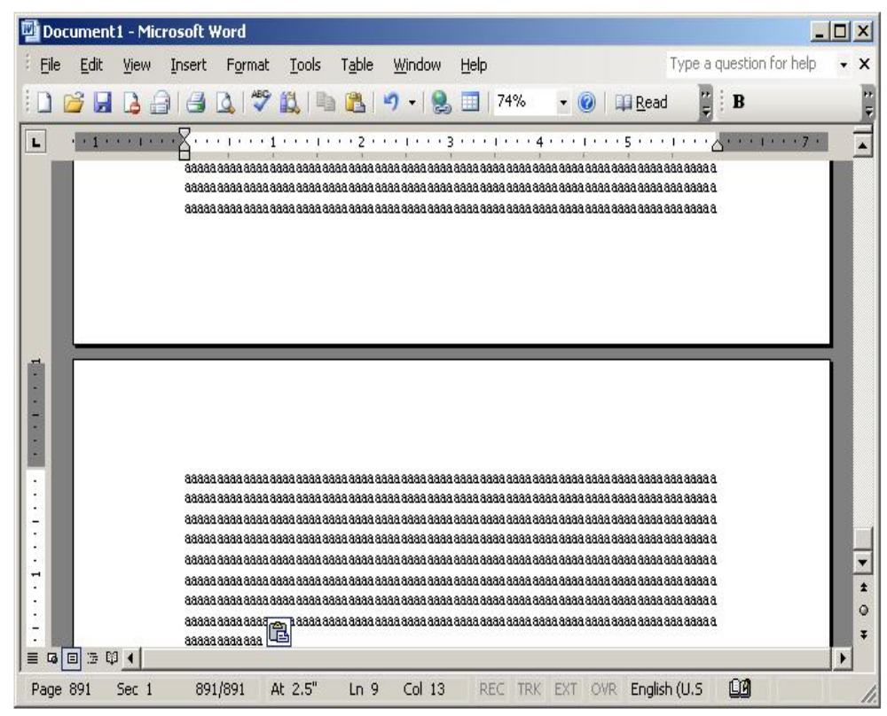

Slide 12
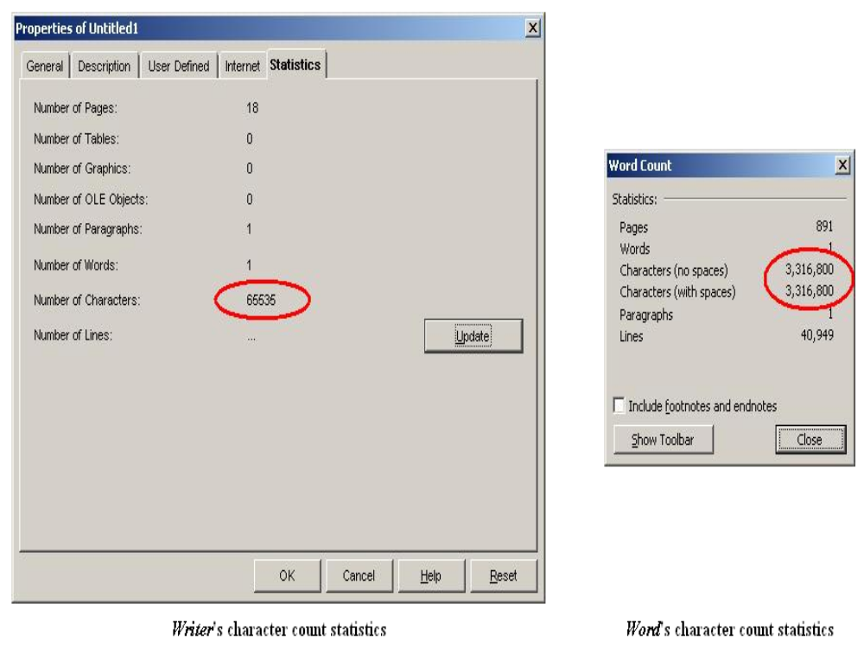

Slide 13
OpenOffice.org Writer: stopped accepting text at 65,535 characters (about 18 pages with size 12 Times New Roman font with standard margins). At the 65,535 character limit, we are unable to add characters by pasting or by typing. We can edit the text already in the document.
-When pasting text that fills the document, the overflow text was cut off without a warning. The user has thus lost data, without necessarily realizing it.
In Word, we saw a completely different situation. After 890 pages, it was still accepting characters. In fact, we could have kept pasting until the system ran out of memory. There is apparently no limit on the amount of characters that Word will accept.
How is this relevant to oracle-based testing? People often write about oracles as test automation support tools. They can be. But as we see here, even in a simple exploration, an oracle can be a useful supplement to specifications and documentation, or a surrogate for these documents if they are unavailable.
Notes:
http://www.testingeducation.org/k04/examples/obas05s.html

Slide 14
Automatic Test Data Generation

Slide 15
Introduction
the process of creating a set of data for testing the adequacy of new or revised software applications. It may be the actual data that has been taken from previous operations or artificial data created for this purpose
Divided in three classes
Random
Path-oriented
Good-oriented test

Slide 16
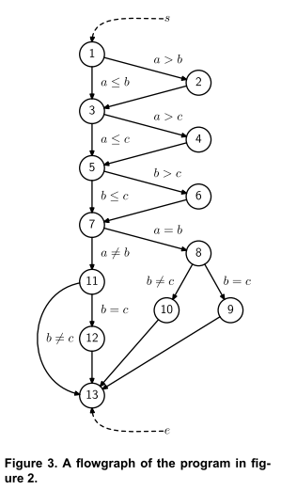

Slide 17
System
Test Data generator
The path selector

Slide 18
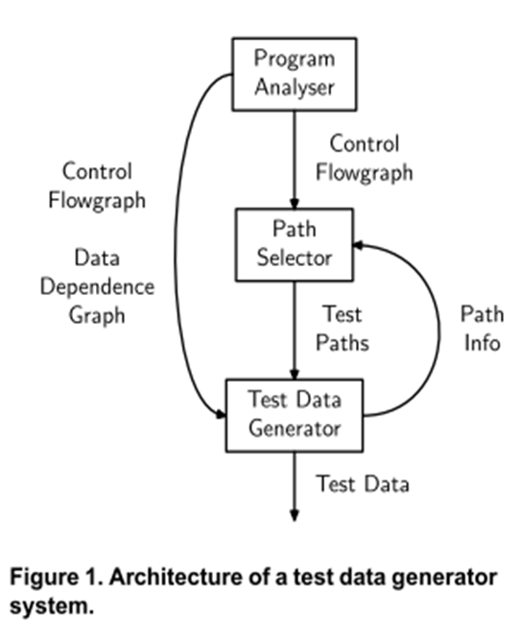
Model
- path selector identifies the paths
test generator derives input data for every path
find an input data set that will traverse the path chosen by the path selector
a) Find the path predicate for the path
b) Solve the path predicate

Slide 19
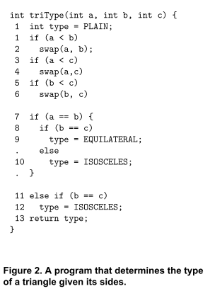

Slide 20
Classifications
Random Test Data Generators
Pathwise Data Generators
Goal Oriented Generators
Intelligent Test Data Generators

Slide 21
Problems
Arrays and pointers
Object
loops
Modules
Infeasible paths
Constraints satisfaction
Oracles

Slide 22
Scenario testing

Slide 23
Definition:
Scenario: A hypothetical story, used to help a person think through a complex problem or system
Scenario test : test based on scenario ,to make sure that the end to end functioning of software is working fine, or all the business process flows of the software are working fine. Test scenario is just a story which explains the usage of the software by any end user.

Slide 24
How it works ?
testers put themselves in the end users shoes and figure out the real world scenarios or use cases which can be performed on the software by the end user. In scenario testing, testers take assistance from clients, stakeholders and developers to create test scenarios.
Generally, scenario testing would deliver three scenarios: a positive (or optimistic), negative (or pessimistic), and neutral (or middle of the road) scenario. These allow a more realistic assessment of future possibilities which does not assume either the best or worst outcomes. The scenarios could also include an unlikely event but one that would have a large impact were it to occur.

Slide 25
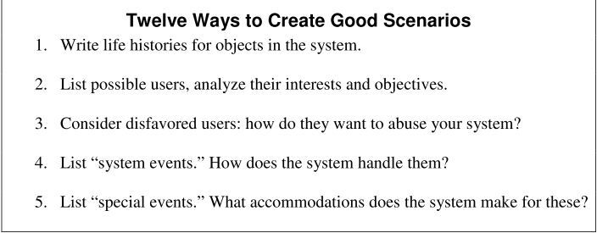
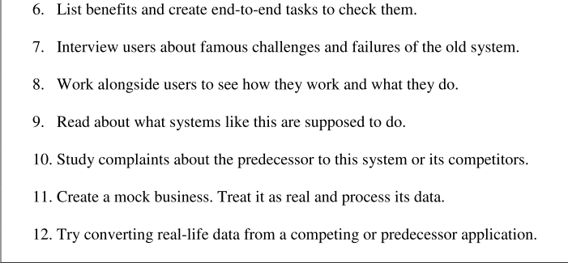

Slide 26
Importance of scenario testing
helps testers to explore how the software will work in the hands of an end user.
tests the business flow of the software, it helps in finding lot of defects which cannot be found with other types of testing.
very important for complex transactions and for studying end-to-end functioning of the program.

Slide 27
Disadvantages
Complex ,involving many features
Use time
Expose design errors than coding errors

Slide 28
Model-Based Testing

Slide 29
Introduction
Definition : MBT tools automatically generate tests cases from a model of the software product. The generated test the executable and include an oracle component which assigns a pass/fail verdict to each test .
Type : automation of black box test design

Slide 30
activities of the practice
Build the model
Generate expected inputs
Generate expected outputs
Run tests
Compare actual outputs with expected outputs
Decide on further actions (whether to modify the model, generate more tests, or stop testing, estimate reliability (quality) of the software)

Slide 31
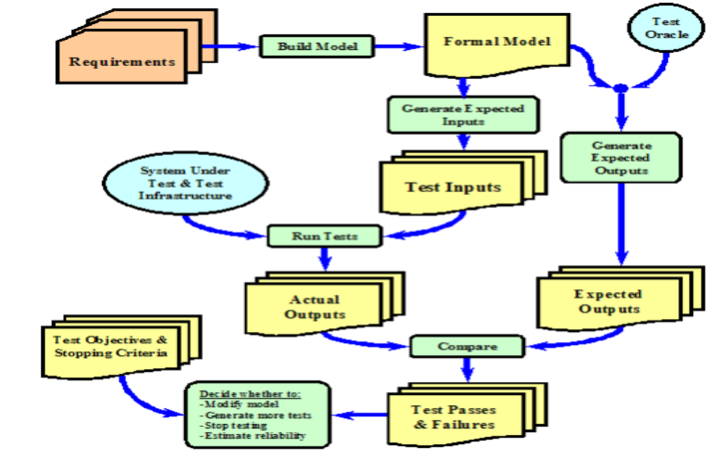
Stages
Notes:
https://goldpractice.thecsiac.com/practices/mbt/

Slide 32
Finding errors in a program
Redundant specification:
Abstract specification
Reasoning technology
Model-based model and Program verifier similarities

Slide 33
Finding errors in a program
Color
Partiality
Model-based model and Program verifier differences

Slide 34
Teaching Domain testing

Slide 35
Introduction
Domain : “a (mathematical) set that includes all possible values of a variable of a function”
Domain testing : This confronts the problem that there are too many test cases for anyone to run. This is a stratified sampling strategy that provides a rationale for selecting a few test cases from a huge population”
Combination testing : programs having multiple variables.

Slide 36
How it works ?
partitioning the input domain, the set of all possible input values, into a finite number of subsets or equivalence classes and
then choosing a few representatives from each class as the candidates for testing
all the members of any such subset are equivalent to each other with respect to the criterion that was used to classify them in their respective subset

Slide 37
Partitioning of Input Domain differs in the literature along the following dimensions:
White or Black:
. White-Box Testing Approach
o Path Analysis Approach
o Mutation Testing Approach
· Black-Box Testing Approach/Specification-Based Approach
o Functional Testing Approach
· Combination of White-Box and Black-Box Testing Approaches

Slide 38
Driving Factor:
· Confidence-based approach
· Risk-based approach
Type of Domain:
· Linear
· Non-linear

Slide 39
Overlapping or Disjoint Subdomains:
· Partitioning into overlapping subdomains
· Partitioning into disjoint subdomains
Size of Subdomains:
· Equally sized subdomains
· No particular sized subdomains
Notes:
http://www.testingeducation.org/a/DTD%26C.pdf

Slide 40
Hierarchical GUI Test case Generation Using Automated Planning

Slide 41
Introduction
GUI : way of interacting with today’s software
Difficulties:
Space of possible interactions with GUI is enormous .
Each sequence of GUI commands can result in a different state .
GUI may need to be evaluated in all of these states .
Determining the coverage of a set of test cases .
Manual creation of test cases and their maintenance, evaluation, and conformance to coverage criteria are very time consuming

Slide 42
Technique presented
testing technique that can automatically generate test cases for GUIs
These tests are composed of certain events: Planning Assisted Tester for grapHical user interface Systems(PATHS)
What are the GUI events that they can generate? user clicks on certain components of a GUI in a particular order.

Slide 43
Overview
GUIs have two type of windows:
GUI windows : contain GUI component
Object windows :not contain GUI component ,display and manipulate objects
The input to the planner is an initial state, a goal state, and a set of operators that are applied to a set of objects
A solution to a given planning problem is a sequence of instantiated operators that is guaranteed to result in the goal state when executed in the initial state.

Slide 44
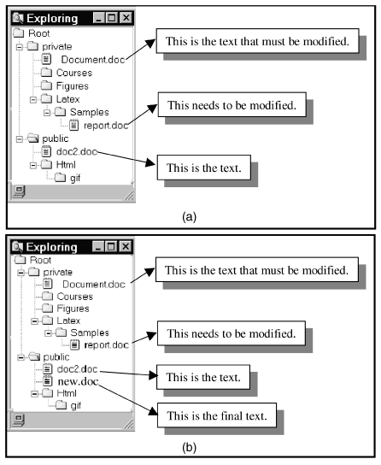
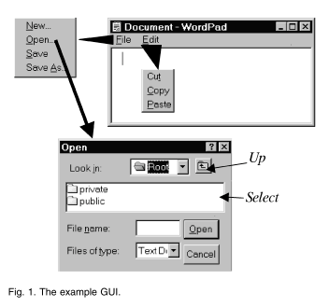

Slide 45
Classification of the events generated by PATHS
Menu-Open Events which expand the GUI events available to the user.
Unrestricted-focus Events which open GUI windows that don't restrict the view's focus, merely expand the GUI events that are available.
Restricted-focus Events which open GUI windows that, once invoked, monopolize the GUI interaction.
System-interaction Events which interact with the underlying software to perform actions.

Slide 46
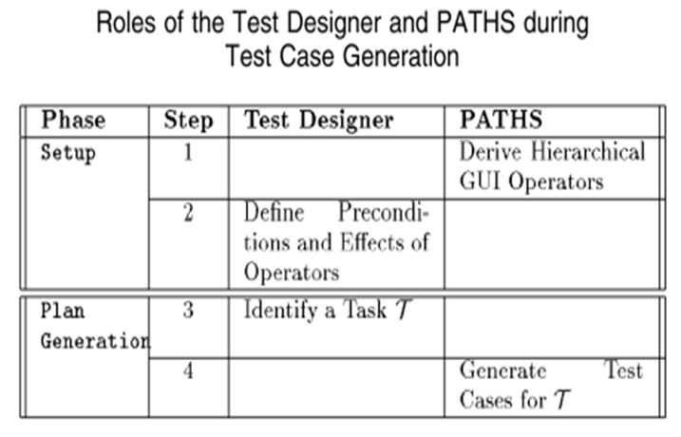
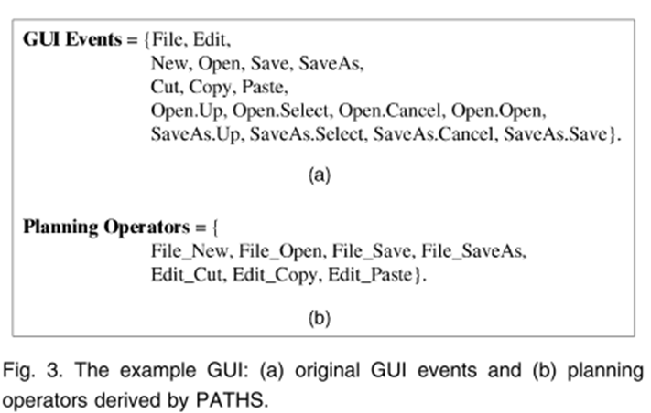
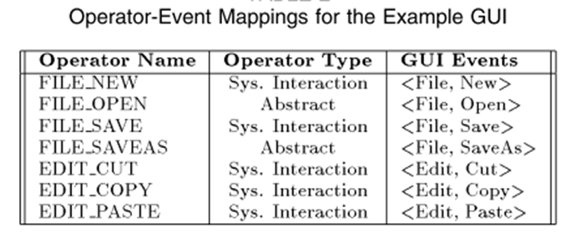
What is a planner? How can a planner to applied to the problem of automatically generating test cases for GUIs?
-develops certain steps to achieve a certain goal
a)initial state,
b)the goal state
c)set of operators
d)set of objects
-Preconditions and effects are defined for each operator.
Notes:
http://www.cs.allegheny.edu/sites/cs290F2002/51

Slide 47
What is a partial-order plan? What does it mean to linearize a partial order plan?
A partial order is an order where not all steps of the plan are ordered with respect to one another
Total-order plans can be derived from these by adding ordering constraints, this is called linearization.

Slide 48
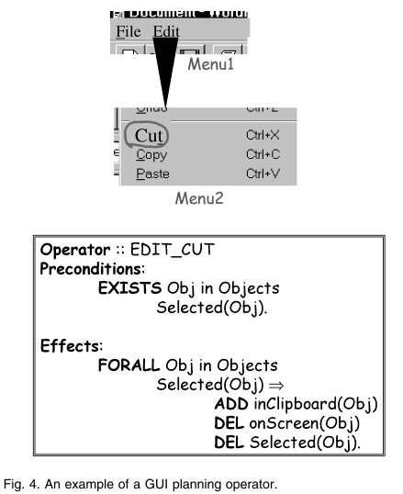
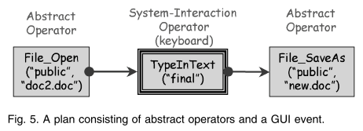

Slide 49
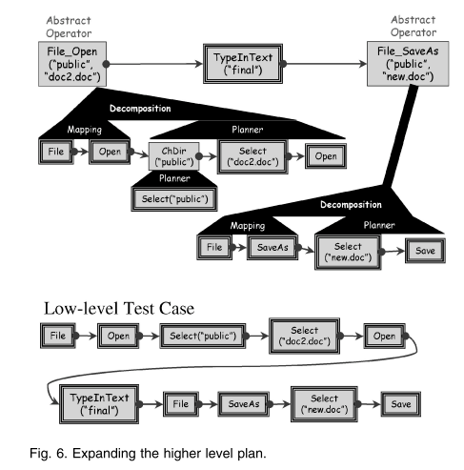
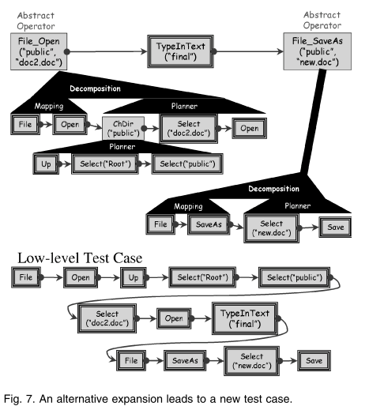

Slide 50
